Slide 1



AI-Based Ballpark Quotation Tool
Checkpoint 2: Develop
Team:
Nida Ejaz
Temur Kuchkorov
Javokhirbek Parpikhodjaev

Slide 2
Table of Contents
Project Recap
Objective & Value Proposition
Data Preparation
Challenges & Distribution
Feature Engineering
Strategy & Key Drivers
Model Development
Selection Strategy & Training
Results & Validation
Performance & Synthetic Test
Next Steps
Checkpoint 2

Slide 3
Project Objective
Develop an AI-based tool for fast ballpark R&D estimations
Automatically extract key information from PR Excel files
Use historical PR–Offer pairs as training data
Predict function-level R&D effort breakdown
Allow Customer Managers and Function Owners to refine results

Slide 4
Value Proposition
For the Customer Manager:
Speed: Instant preliminary estimations replace days of manual analysis.
Accuracy: Data-driven predictions improve consistency across all quotations.
Efficiency: Drastic reduction in manual workload, allowing focus on high-value tasks
For the Business:
Agility: Faster "Go/No-Go" decisions accelerate the sales cycle.
Standardization: A unified process across all functions and departments

Slide 5


Sustainable Development Goal
SDG 9: Industry, Innovation and Infrastructure
Enhancing industrial capability through digitalization and AI-driven automation.
SDG 12: Responsible Consumption and Production
Reducing "Engineering Waste" by minimizing duplicated efforts and optimizing resource planning

Slide 6
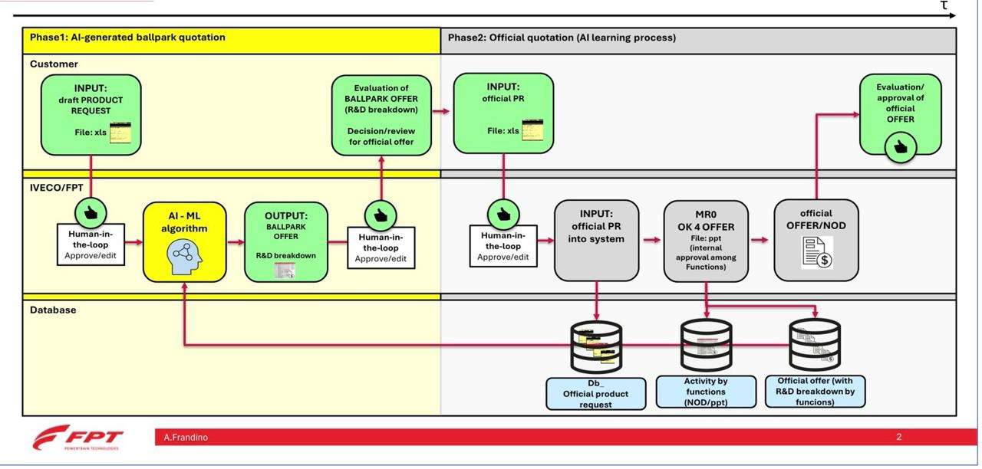
Functional Diagram

Slide 7
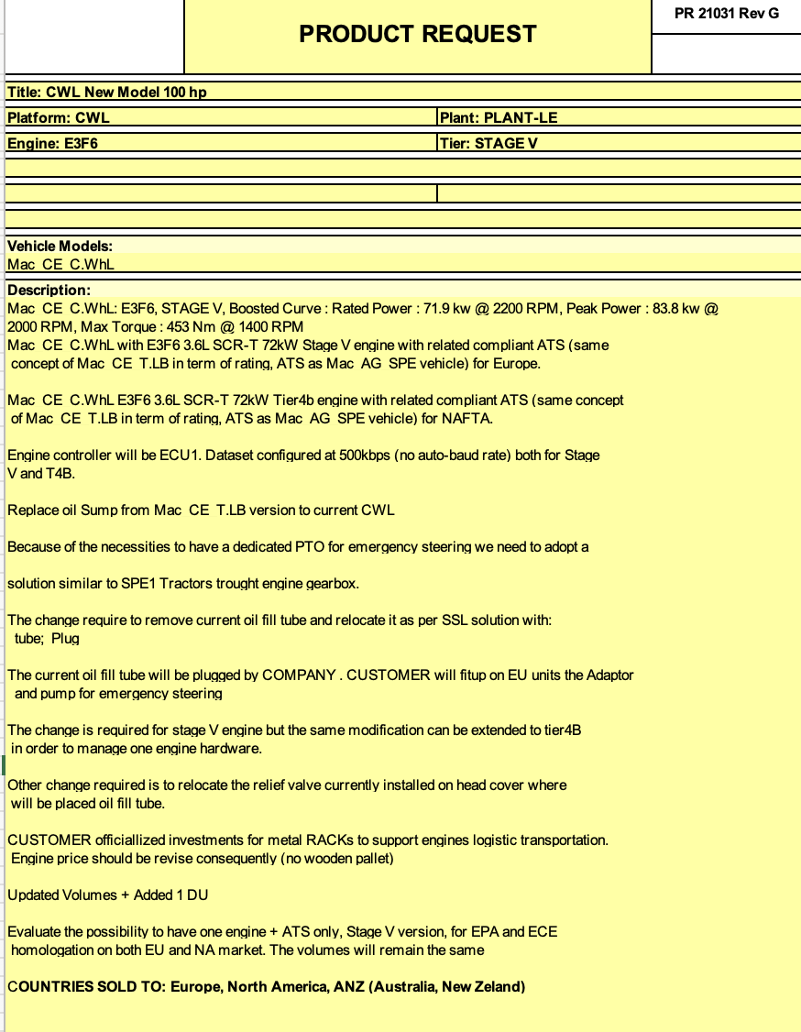
Data Overview 1/2

Slide 8
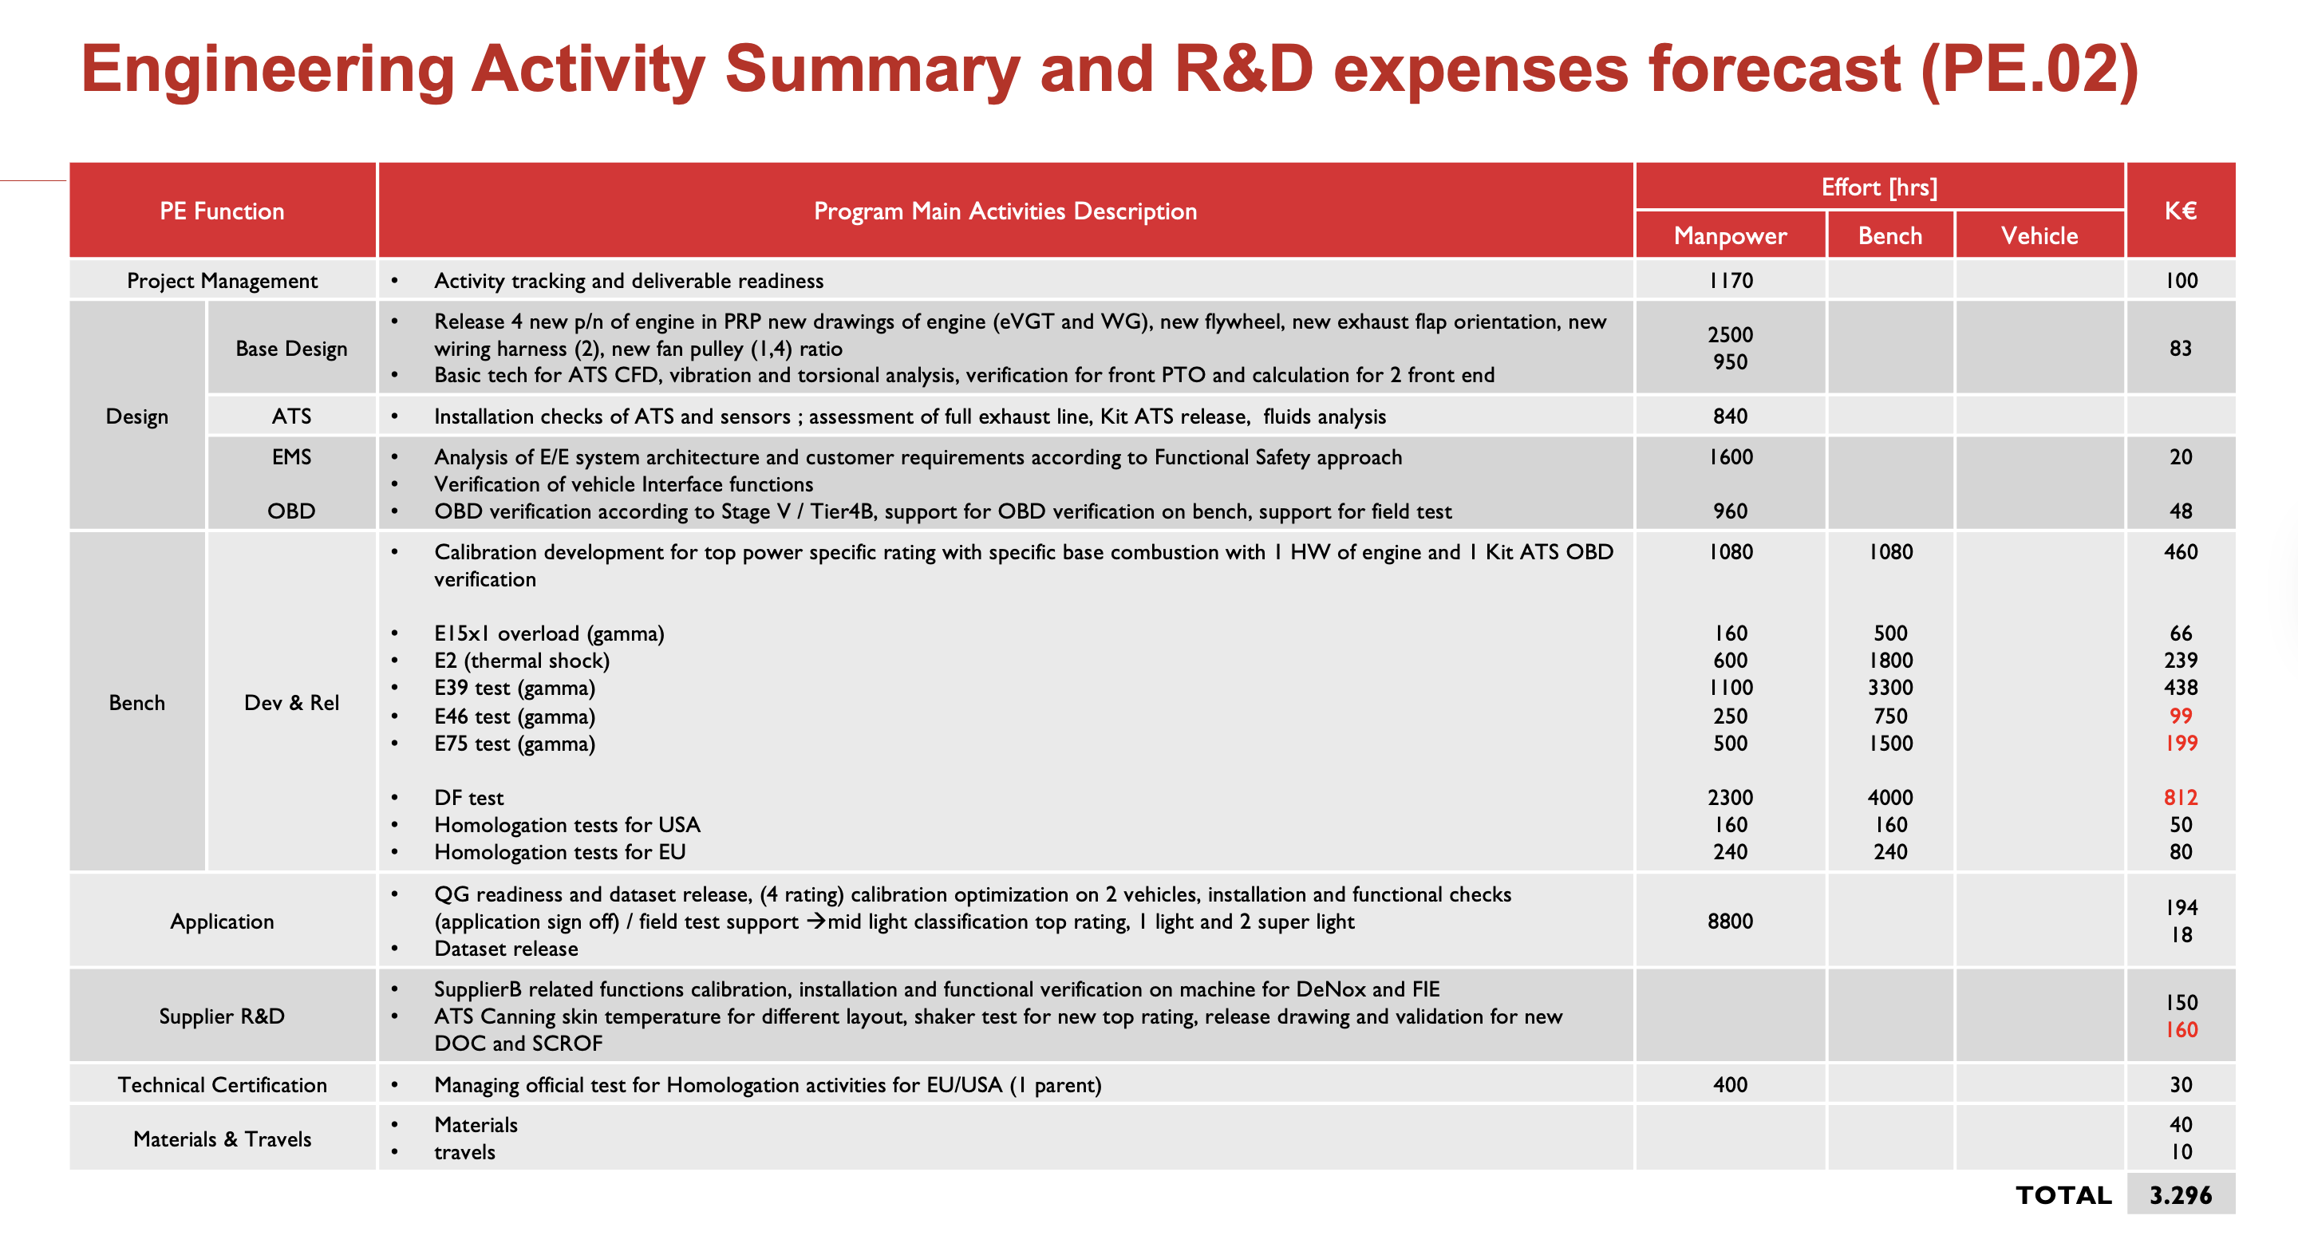
Data Overview Proposed quote 2/2

Slide 9
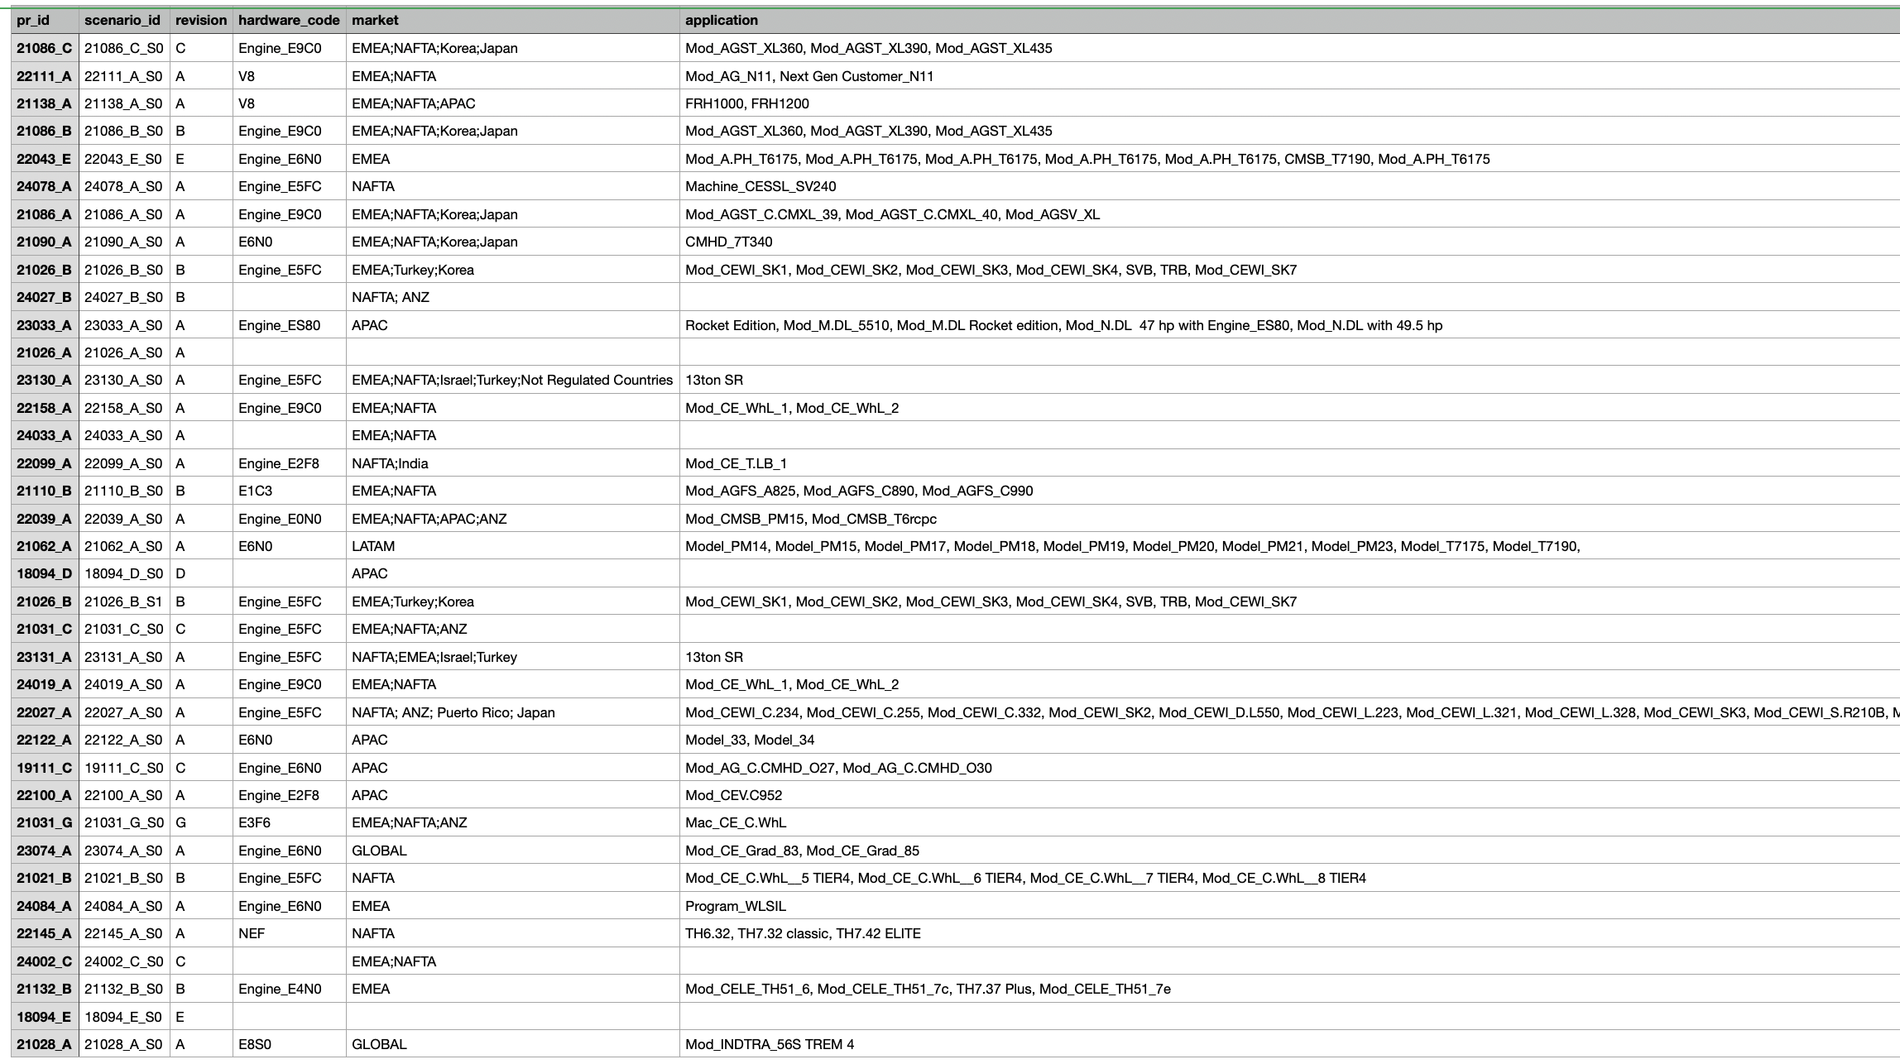
Data Collection and Preparation – CSV File

Slide 10
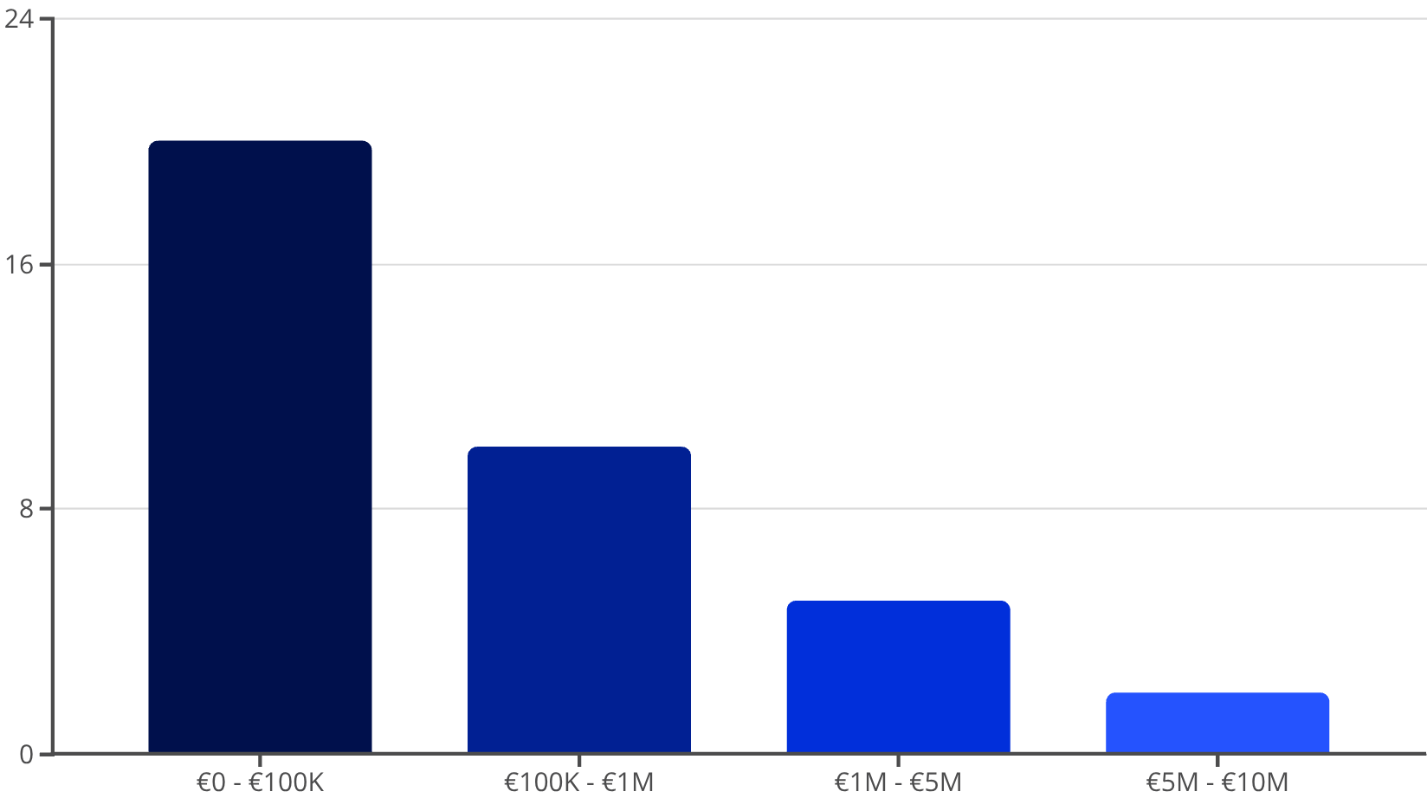
The Data Challenge
Key Statistics:
Dataset: very small, 37 Cleaned Historical Projects
Cost Range: €7K to €5M.
Challenge: Extreme variance requires Log-Transformation
Histogram of Project Cost Distribution

Slide 11
Research Questions
RQ1: Which technical PR features have the highest correlation with R&D effort per function?
RQ2: Which activities are affecting the cost of each function?
RQ3: Can synthetic data improve model performance given the very limited number of historical PR–Offer pairs?
RQ4: Which ML model (RF, XGBoost, Linear Models, Transformers?) gives the most interpretable & accurate predictions?
RQ5: How consistent are AI-generated ballpark estimations compared to expert-generated historical offers?

Slide 12




Feature Engineering Strategy
Log-scale applied to Hours & Costs
Design Ratio & Calibration Ratio
Transformation
Ratios Created
One-Hot Encoding for Project Sizing
12 Engineered Features ready for ML
Encoding
Result

Slide 13

Engineering Features for Better Prediction
Handling Variance: Applied Log-Transformation to Total Hours and Cost to stabilize the extreme range (€7k vs €5M).
Capturing Complexity: Created Ratios (e.g., Calibration Ratio) because the proportion of work often dictates complexity more than just raw hours.
Categorical Context: Used One-Hot Encoding for Sizing Level (Small, Mid, Full) to help the model distinguish between project scales

Slide 14
Feature Importance (Drivers of Cost)
What Drives the Cost?
Driver 1: Overhead Hours (47.5% importance) — administrative complexity is the biggest cost factor.
Driver 2: Calibration Hours (17.9%) — technical tuning is the second most critical predictor.
Driver 3: Bench Development (15.5%) — hardware testing phases significantly impact the budget.

Slide 15


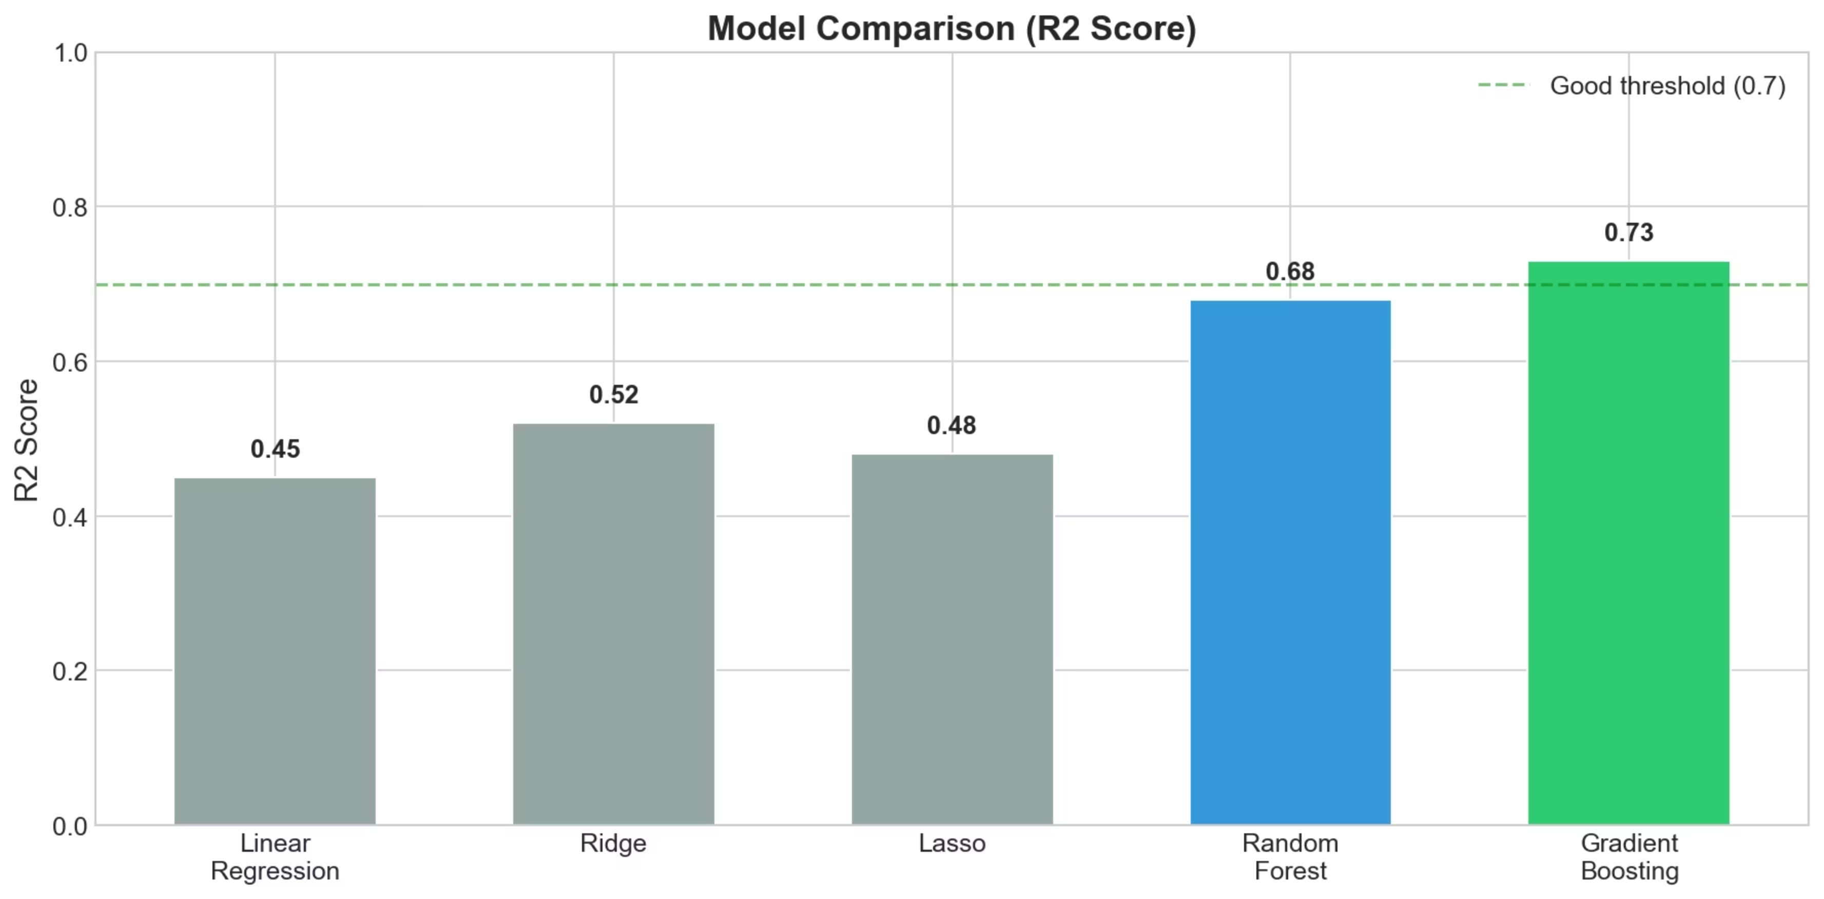
Model Selection Strategy
Linear Regression
Neural Networks
Gradient Boosting
Too simple for complex R&D costs
Overfitting risk on small data
Chosen: Robust to outliers, best for tabular data
Gradient Boosting achieves the highest R² Score (0.73), exceeding the 0.7 threshold for good model performance. It outperforms simpler models (Linear, Ridge, Lasso) and ensemble alternatives (Random Forest), making it the optimal choice for this complex R&D cost estimation task.

Slide 16
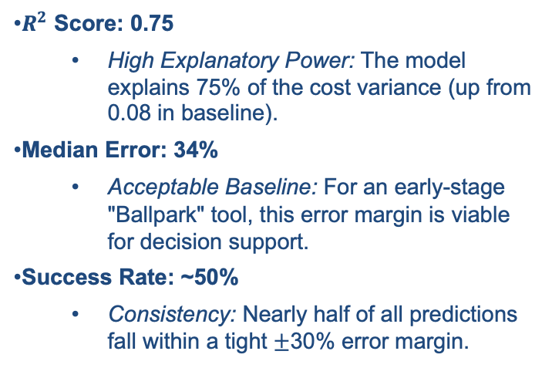
Validation Strategy & Model Performance
Strategy: Leave-One-Out Cross-Validation (LOO)
The Challenge: With only 37 samples, a standard 80/20 split leaves too few examples for testing, leading to unstable results.
The Solution: We implemented LOO Cross-Validation:
Train the model on 36 projects.
Test on the 1 remaining project.
Repeat 37 times (once for each project).
Benefit: This maximizes the training set while ensuring every single data point is tested effectively.
$R^{2}$ Score: 0.75
High Explanatory Power: The model explains 75% of the cost variance (up from 0.08 in baseline).
Median Error: 34%
Acceptable Baseline: For an early-stage "Ballpark" tool, this error margin is viable for decision support.
Success Rate: ~50%
Consistency: Nearly half of all predictions fall within a tight $±$30% error margin.

Slide 17

Approach with Synthetic Data Generation and LLM Usage
The Data Scarcity Problem
Only 37 Real Projects
We possess historical data, but the volume is drastically insufficient for robust Machine Learning training.
The Consequence
Severe overfitting risk
•
Model memorizes data instead of learning patterns
•
•
Unreliable predictions on new quotes
Target: We need 500+ samples to generalize effectively.

Slide 18


Two Approaches Attempted In Synthetic data generation phase
Industry Standard (Failed)
Domain-Informed (Success)
We initially deployed a Conditional Tabular GAN (Generative Adversarial Network), a state-of-the-art deep learning model for tabular data synthesis.
We developed a custom algorithm that encodes engineering domain knowledge directly into the generation process.
Result: Lost critical business logic.
Result: Preserved causal relationships.
Correlation: ~0.0 (Random noise).
Outcome: Model R² = 49.3% (Improved).
Outcome: Model R² = 32.9% (Poor).

Slide 19
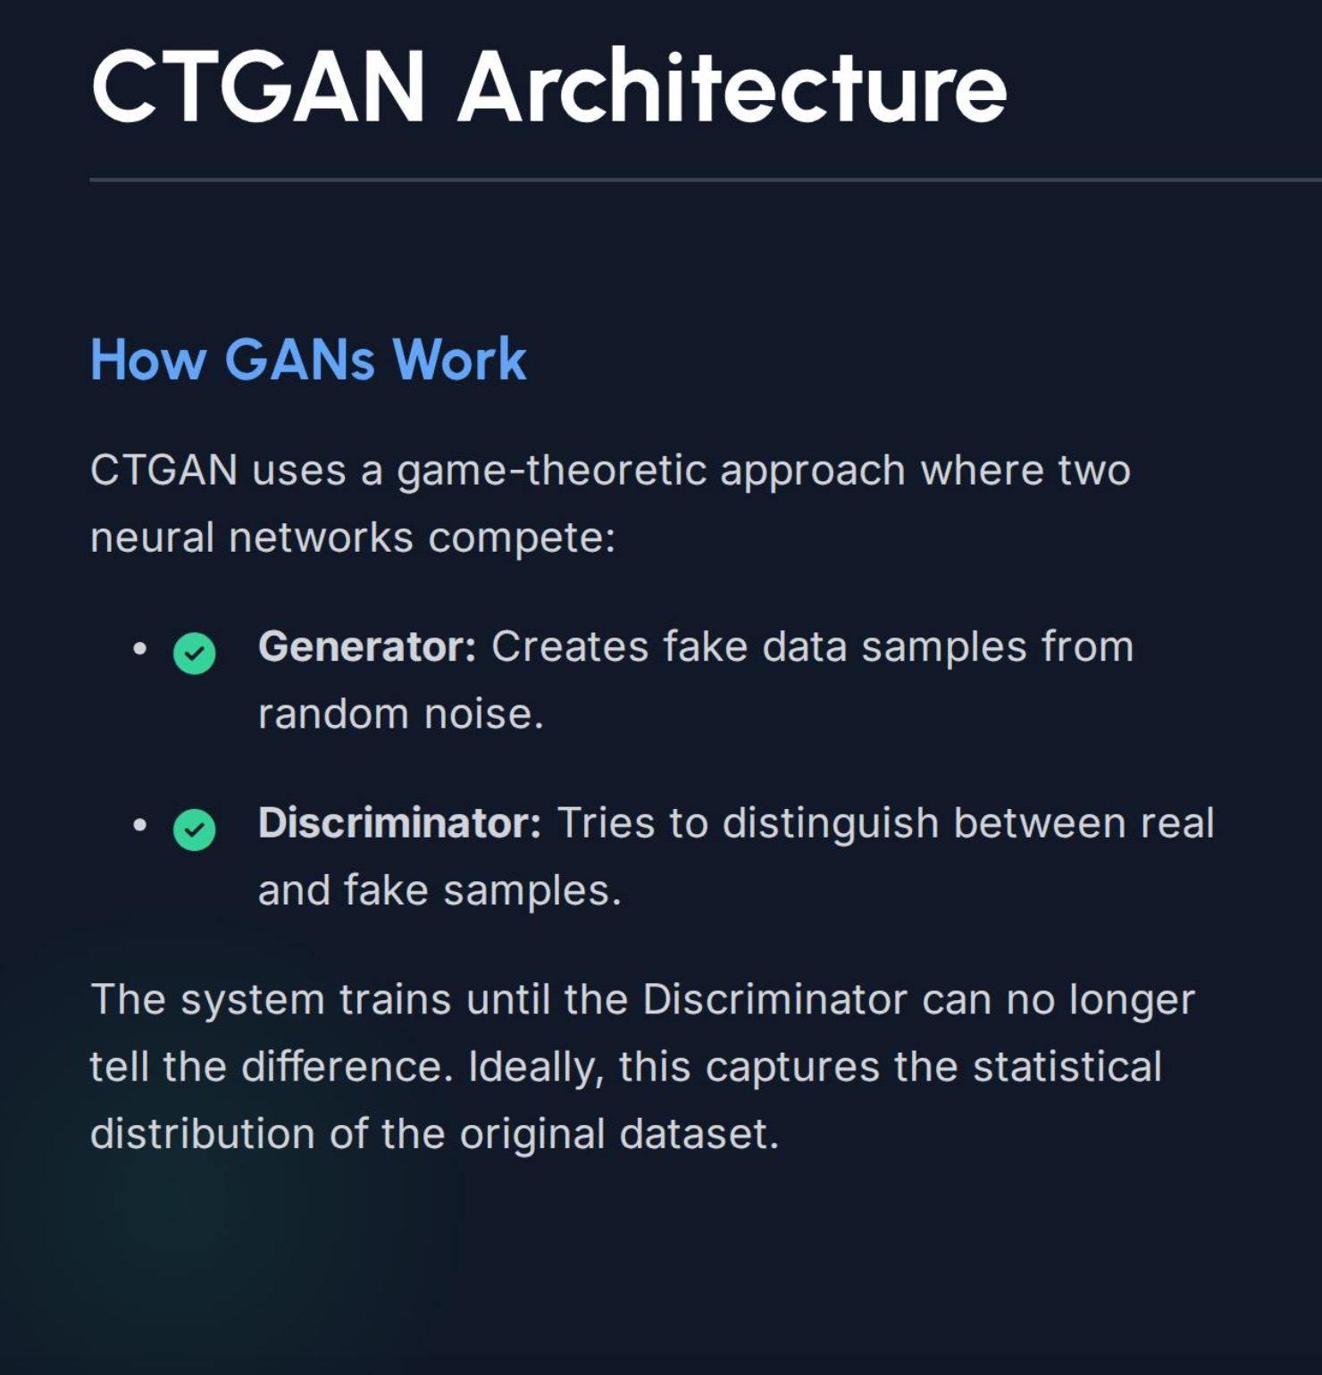
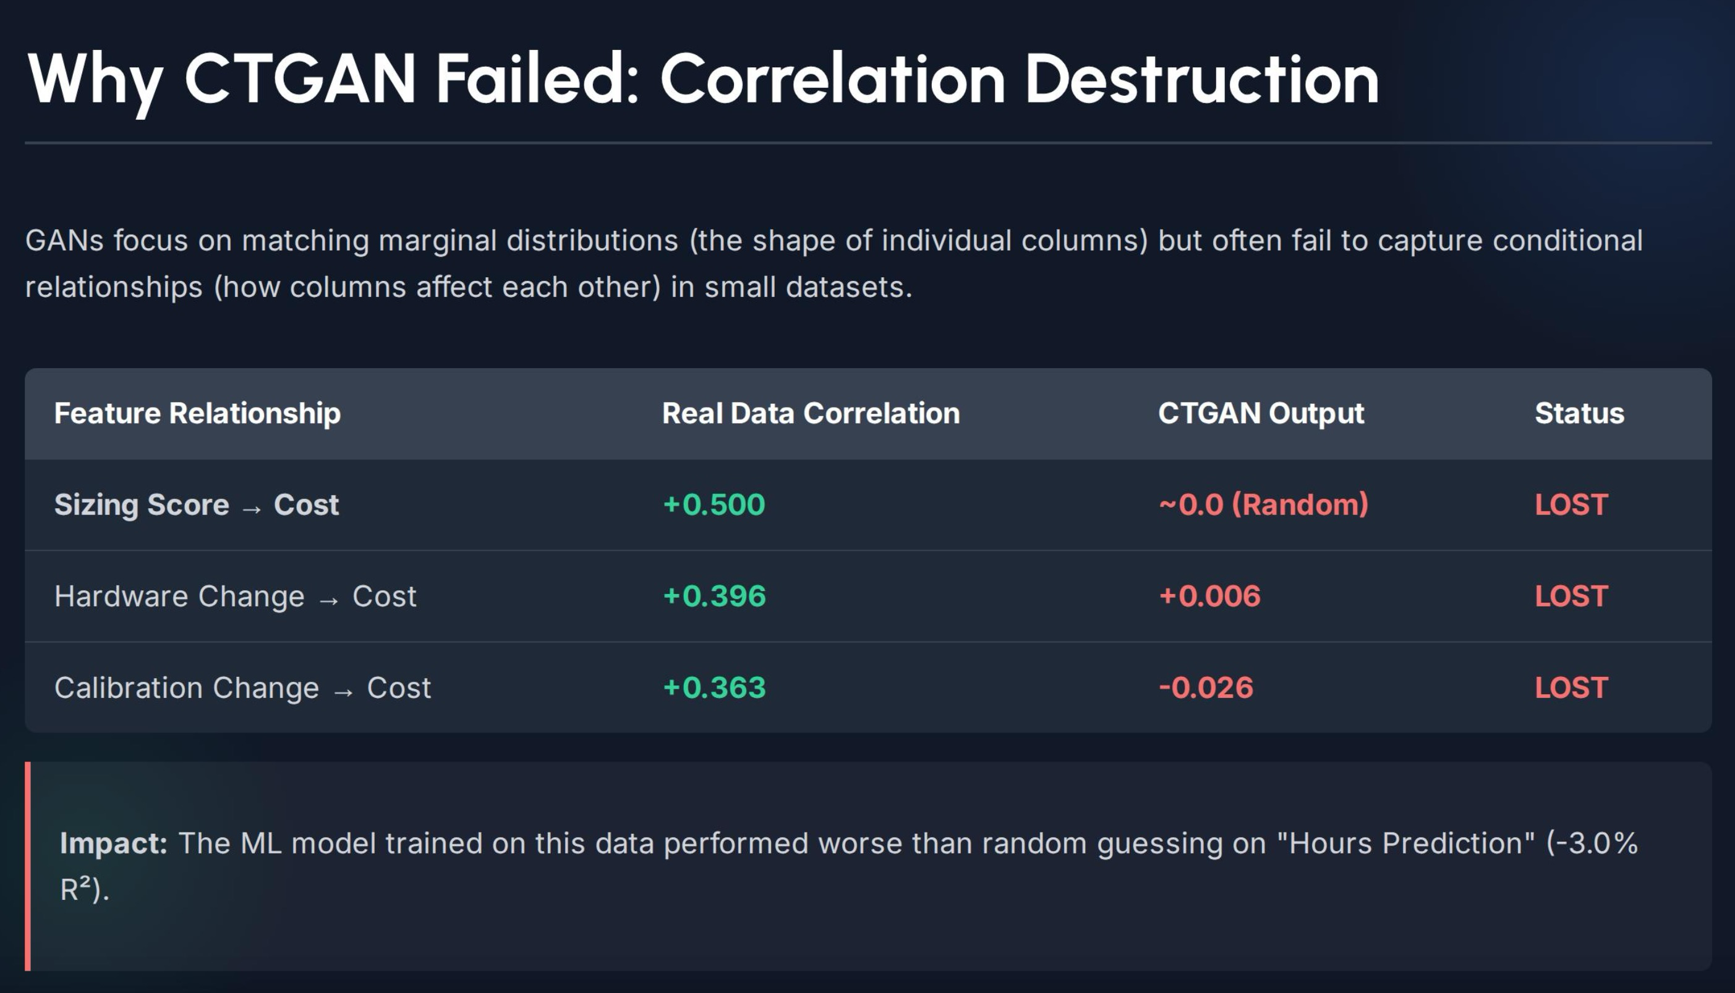

Slide 20






Solution: Correlation-Preserving Generation
Instead of letting a neural network guess the relationships, we explicitly encoded domain knowledge as mathematical rules.
Domain Logic
Distribution Sampling
Causal Links
Hard-coded rules derived from engineering expertise (e.g., "Hardware changes always increase cost").
Base costs are sampled from normal distributions specific to project sizing (Small, Medium, Large).
Features are generated first, then multipliers are applied to the base cost, preserving cause-and-effect.

Slide 21
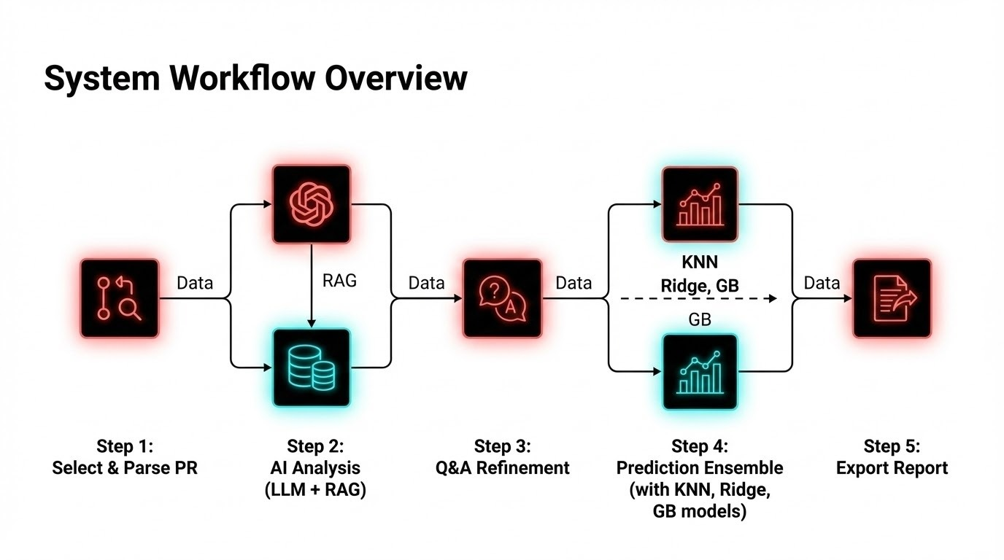
LLM Based Pipeline and Interface for Tool

Slide 22



Step 1: Input & Parsing
PRExcelParser Module
PRDocument Dataclass
Structured data container holding extracted information.
Processes raw .xls dataset files using Regex patterns to identify key identifiers.
•
ID Pattern: PR_(\d+)_rev_([A-Z])
•
Product Families: NEF, CURSOR, F1, E0C0
•
Target: Extracts raw text for LLM processing.

Slide 23






Step 2: AI Analysis Engine
LLM Engine
System Prompt
LLMAnalysis Extraction
Powered by DeepSeek V3 via OpenRouter API.
"You are an expert R&D Cost Estimation Engineer at FPT Industrial..."
•
Boolean Flags (Hardware/ATS change)
Context window optimized for technical documentation reading and feature extraction.
Embeds domain knowledge: Sizing levels (X-small to Full) and Cost Drivers.
•
Complexity Score (1-10)
•
Initial Cost & Sizing Estimate
•
Missing Info Identification

Slide 24
Step 2: Vector Store (RAG)
FPT Knowledge Base
Retrieval Augmented Generation injects domain expertise into the LLM context.
•
Database: ChromaDB (Localhost:8000)
•
Embeddings: all-MiniLM-L6-v2 (384-dim)
•
Content Types:
○
Acronyms (ATS, DOC, SCR)
○
Sizing Definitions (Cost/Hours)
○
Historical Projects (N=37)

Slide 25


Step 3: Human-in-the-Loop
Question Generation
Refinement Logic
The LLM analyzes low-confidence areas in the initial extraction.
incorporate_answers()
•
Identify missing scope items.
User inputs via Streamlit UI are fed back into the LLM to update the LLMAnalysis dataclass.
•
Clarify ambiguous requirements.
•
"Is this a new certification or carry-over?"
•
Updates Sizing & Cost estimates.
•
Updates Confidence score.
•
Allows manual override of Boolean flags.

Slide 26





Step 4: Prediction Ensemble
KNN (40%)
Ridge (25%)
GB (35%)
K-Nearest Neighbors
Ridge Regression
Gradient Boosting
Finds the most similar historical projects based on feature vectors. Best for precedent-based estimation.
Captures linear relationships between cost drivers and total cost. Applies L2 regularization to prevent overfitting.
Handles non-linear patterns and complex interactions between features (e.g., Engine Family + ATS Tech).
Uncertainty: Conformal Prediction guarantees 90% coverage intervals.

Slide 27
Step 5: Excel Generation
PE.02 Forecast Report
A comprehensive 6-sheet Excel file generated using openpyxl, styled with FPT Brand colors.
•
Sheet 1: Executive Summary (Cost, Hours, Confidence)
•
Sheet 3: AI Understanding (Scope & Features)
•
Sheet 4: PE.02 Breakdown (A1-D R&D Functions)
•
Sheet 6: Similar Projects (Validation Data)

Slide 28

Complete Data Flow
Data travels from raw Excel input through the Parsing Module, is enriched by the Vector Store, processed by the LLM Engine, refined by User Input, predicted by the ML Ensemble, and finally exported.
Key Dataclasses:
•
PRDocument
•
LLMAnalysis
•
FeatureVector
•
PredictionResult
•
ReportData

Slide 29




Technology Stack
Core Logic
AI Model
Vector DB
Frontend
Python 3.9+
DeepSeek V3
ChromaDB
Streamlit
Pandas, NumPy, Scikit-Learn
via OpenRouter API
Sentence Transformers
Wizard Interface

Slide 30
What’s Next?
Collect more data and analyse this.
Finalize the features.
Test extraction accuracy
Create first version of synthetic data
Train baseline ML models
Prepare internal demo for IVECO manager

Slide 31


THANK YOU

